Slide 1

Routing and Scheduling
in Community Nursing
Carlos Lamas Fernández
Thomas Monks
NIHR CLAHRC Wessex , University of Southampton
Toni Martínez-Sykora
CORMSIS, University of Southampton

Slide 2
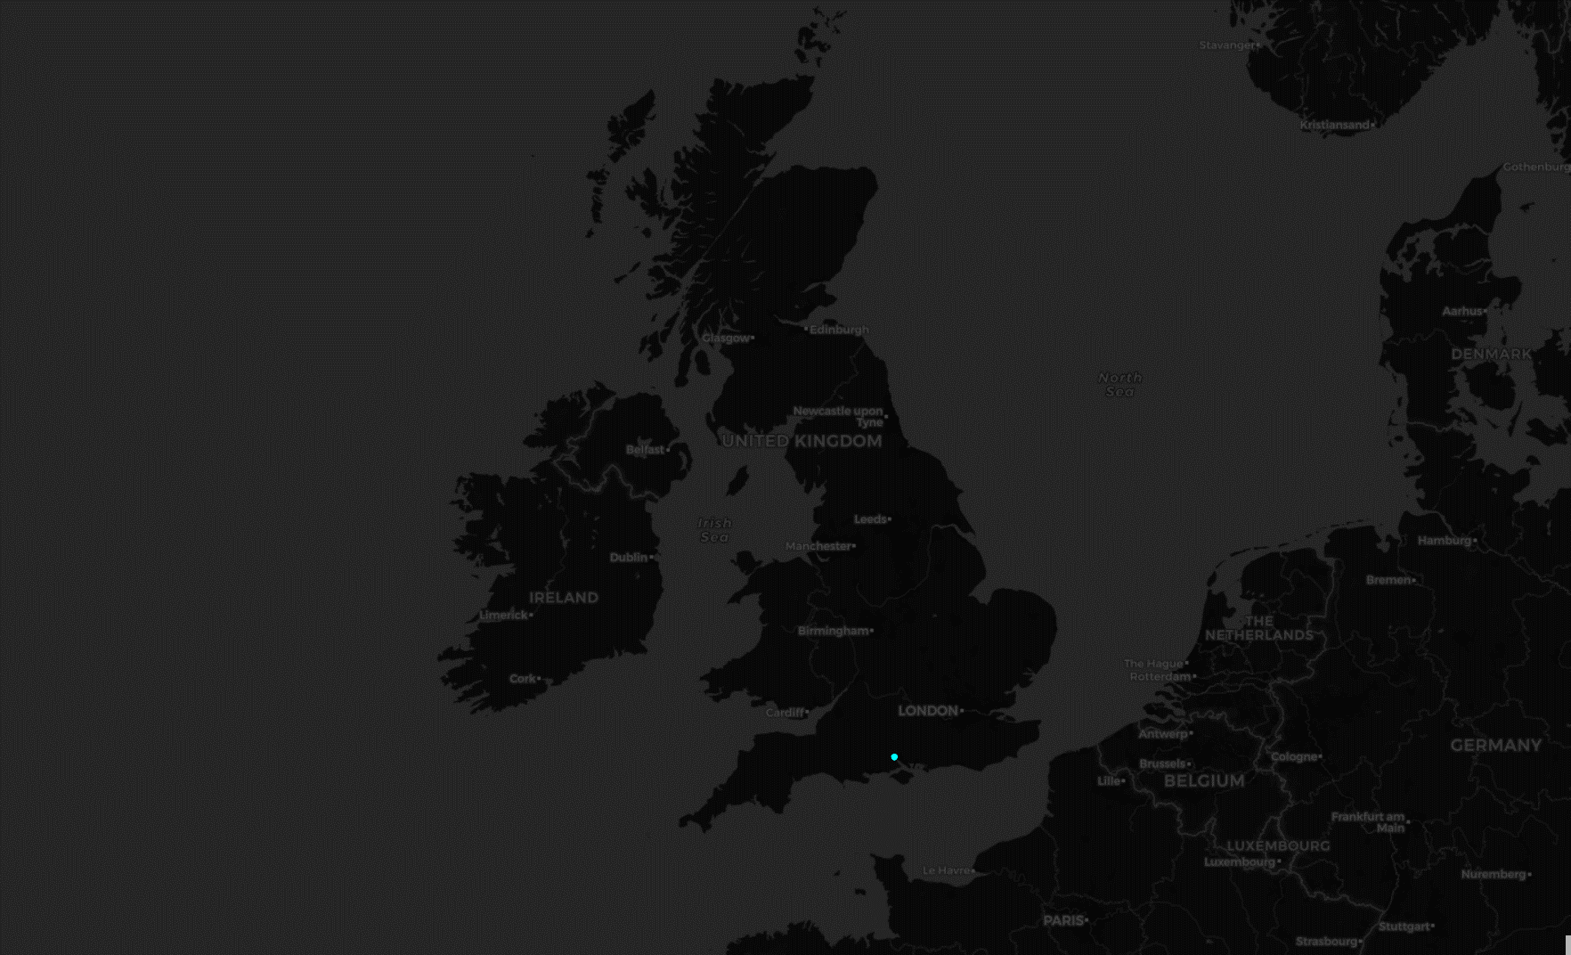
Southampton

Slide 3
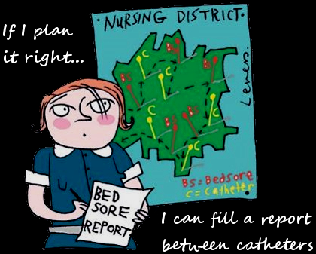

Slide 4
Skills required
Time
required
List of services
Service ID | Patient | Address | Time window | Service type | Other considerations
0001 | Ann Patient | Road, Postcode | 9am - 11am | Insulin | Cat
0002 | John Smith | Road, Postcode | 8am - 5pm | Other treatment | 2 Nurses
0003 | John Smith | Road, Postcode | 8am - 5pm | Insulin | At least 30 min after 0002
... | ... | ... | ... | ... | ...
List of available nurses
Incompatibilities
Nurse ID | Skills | Shift | On-call | Starts from | Preferences
0001 | Insulin | Day | Yes | Home (Address)
0002 | Blood test | Day | No | Hospital | No cats
0003 | Blood test, Insuline | Evening | No | Hospital
... | ... | ... | ... | ... | ...

Slide 5
Problem definition
Home Health Care Routing & Scheduling Problem (HHCRSP)
Single period scheduling
“Rich” Vehicle Routing Problem
Many constraints & quality measures

Slide 6
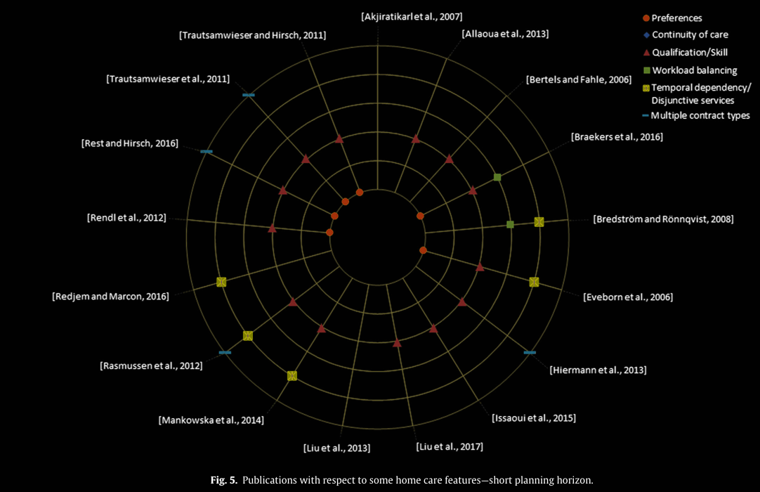
(Cissé et al 2017)

Slide 7

9 AM
11 AM
1 PM
3 PM
Time window Job 1
Time window Job 3
Nurse 1
JOB 2
JOB 1
tardiness
tardiness
Nurse 2
JOB 2
JOB 2
JOB 3
JOB 3
waiting time
Dependency
Job 1
JOB 1
Time window
JOB 2
Double service
JOB 3
Time window, dependency on Job 1

Slide 8

Objective functions
Mankowska et al (2014)
$z= \frac{Total travel}{3}+\frac{Total Tardiness}{3}$ + $\frac{Maximum tardiness}{3}$
Haddadene et al (2016)
$z=\left(Total travel\right)+(Total preferences)$

Slide 9
Schedule quality measures
Tardiness
Total time
Travel time
Preference score
Workload balance
“Fairness” of solutions

Slide 10

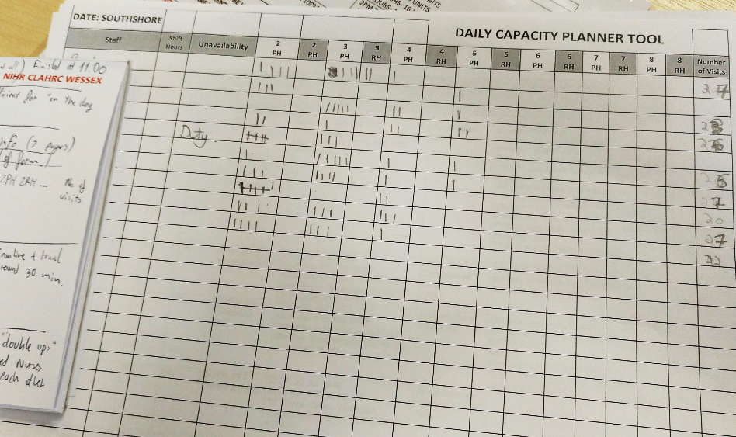
Currently used method

Slide 11




Our approach
Patient information
Location
Skill needed
Time needed
Time window
Dependency with other services
Preferences
Staff information
Starting location
Skills / Band
Working shift
Preferences

Slide 12

Methodology
Randomised constructive
Local Search
Path Relinking
GRASP

Slide 13
Randomised Constructive
Select a random nurse ordering
Start one route for each nurse
Evaluate all possible insertions
Generate a RCL with the top %
Add randomly one service from the RCL

Slide 14
Local Search
Move
Exchange
Remove & Reinsert dependent services

Slide 15
Preliminary computational results
Mankowska et al (2014)
Haddadene et al (2016)
Instance | Pts | Lit. Best | GRASP Best
A1 | 10 | 218.2 | 218.2
A2 | 10 | 246.6 | 246.6
A3 | 10 | 305.9 | 305.9
A4 | 10 | 186.9 | 186.9
A5 | 10 | 189.5 | 189.5
A6 | 10 | 200.1 | 200.1
A7 | 10 | 225.4 | 225.4
A8 | 10 | 232 | 272.4
A9 | 10 | 222.3 | 222.3
A10 | 10 | 225 | 225
B1 | 25 | 458.9 | 428.1
B2 | 25 | 476.2 | 476
B3 | 25 | 399.2 | 407.2
B4 | 25 | 576 | 416.8
B5 | 25 | 391.1 | 371.3
B6 | 25 | 534.7 | 441.7
B7 | 25 | 355.5 | 328.7
B8 | 25 | 357.8 | 361.7
B9 | 25 | 403.8 | 404.6
B10 | 25 | 500.4 | 462.7
Instance | Pts | Lit. Best | GRASP Best
C1 | 50 | 1123.6 | 951.7
C2 | 50 | 673.8 | 590.6
C3 | 50 | 642.4 | 562.2
C4 | 50 | 580.4 | 517.9
C5 | 50 | 754.6 | 661.1
C6 | 50 | 951.6 | 833.8
C7 | 50 | 577.4 | 534.6
C8 | 50 | 540.6 | 478.6
C9 | 50 | 608.7 | 560.6
C10 | 50 | 679.3 | 608.5
D1 | 75 | 1321.8 | 1171.6
D2 | 75 | 892.7 | 764.5
D3 | 75 | 819.4 | 717
D4 | 75 | 877.4 | 838.2
D5 | 75 | 872.1 | 779.4
D6 | 75 | 835.2 | 770.6
D7 | 75 | 706.3 | 605.4
D8 | 75 | 811.4 | 721.8
D9 | 75 | 842.7 | 723.1
D10 | 75 | 1306.6 | 1223.3
Instance | Pts | Lit. Best | GRASP Best
18-4-s-2a | 18 | 40.13 | 40.13
18-4-s-2b | 18 | 81.15 | 84.36
18-4-s-2c | 18 | 34.78 | 38.28
18-4-s-2d | 18 | 55.26 | 61.91
18-4-m-2a | 18 | 57.42 | 57.42
18-4-m-2b | 18 | 21.31 | 25.63
18-4-m-2c | 18 | 49.68 | 53.88
18-4-m-2d | 18 | 51.27 | 51.27
18-4-m-2e | 18 | 36.39 | 36.39
18-4-l-2a | 18 | 18.14 | 18.14
18-4-l-2b | 18 | 4.91 | 8.13
18-4-l-2c | 18 | 27.39 | 28.47
18-4-l-2d | 18 | 44.91 | 44.91
18-4-l-2e | 18 | 9.78 | 12.59
45-10-s-3a | 45 | -82.01 | -78.03
45-10-s-2a | 45 | -37.79 | -34.86
45-10-s-3b | 45 | -35.74 | -35.74
45-10-s-2b | 45 | -97.42 | -97.42
45-10-s-3c | 45 | -97.13 | -97.13
Instance | Pts | Lit. Best | GRASP Best
45-10-m-4 | 45 | -96.97 | -96.04
45-10-m-2a | 45 | -43.1 | -43.10
45-10-m-2b | 45 | -120.65 | -120.65
45-10-m-3 | 45 | -124.06 | -124.06
45-10-l-2a | 45 | -107.94 | -108.54
45-10-l-2b | 45 | -147.27 | -147.27
45-10-l-3 | 45 | -150.64 | -150.64
45-10-l-4 | 45 | -153.63 | -154.41
73-16-s-2a | 73 | -196.14 | -186.22
73-16-s-3 | 73 | -198.99 | -183.99
73-16-s-2b | 73 | -196.14 | -187.14
73-16-m-3a | 73 | -198.99 | -192.97
73-16-m-2 | 73 | -211.8 | -211.01
73-16-m-3b | 73 | -217.51 | -215.11
73-16-l-2 | 73 | -309.94 | -304.63
73-16-l-3 | 73 | -306.19 | -309.65
73-16-l-4 | 73 | -309.93 | -310.01
73-16-l-5 | 73 | -308.57 | -314.95

Slide 16
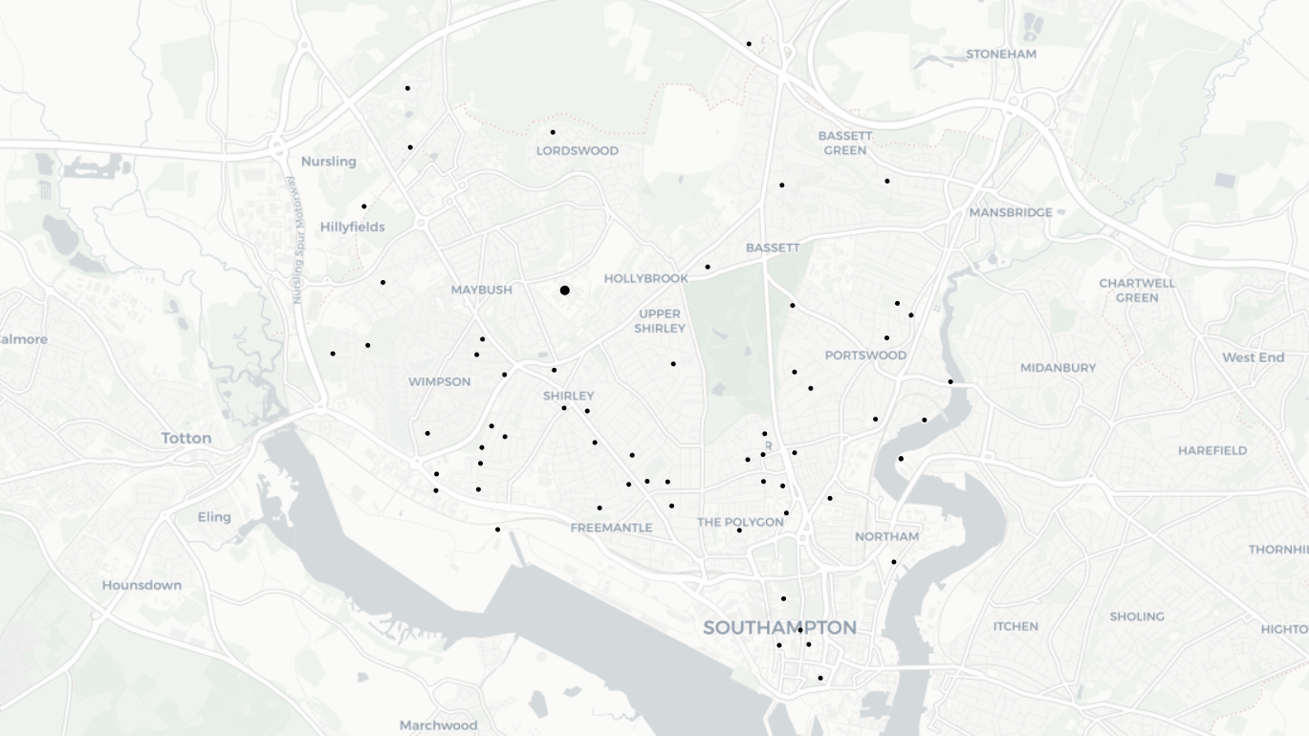
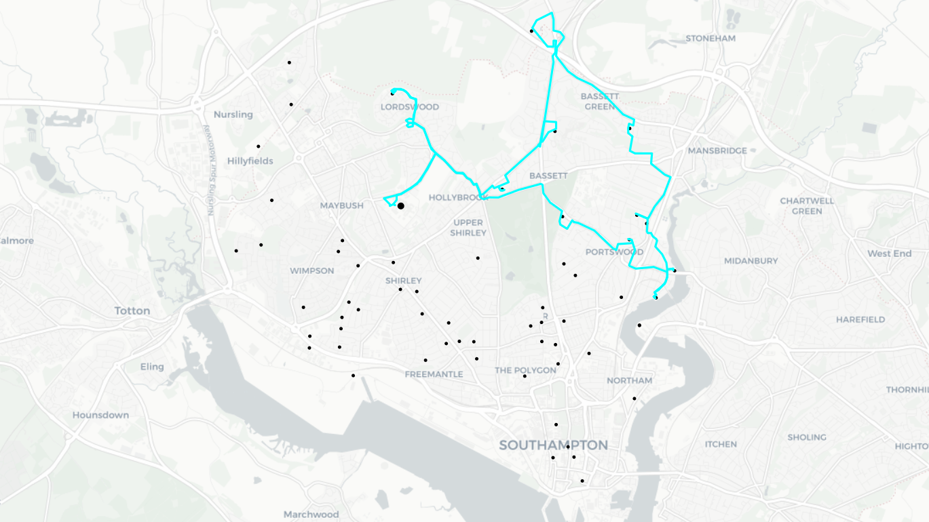
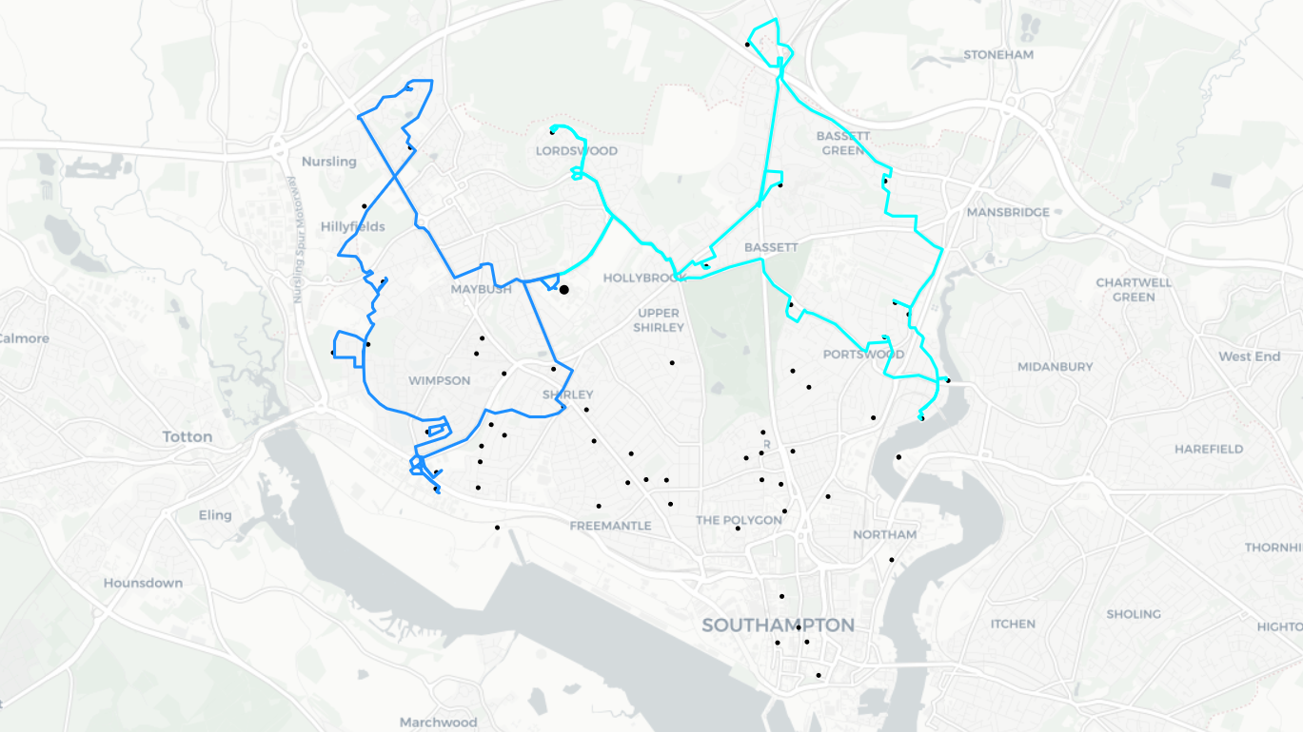
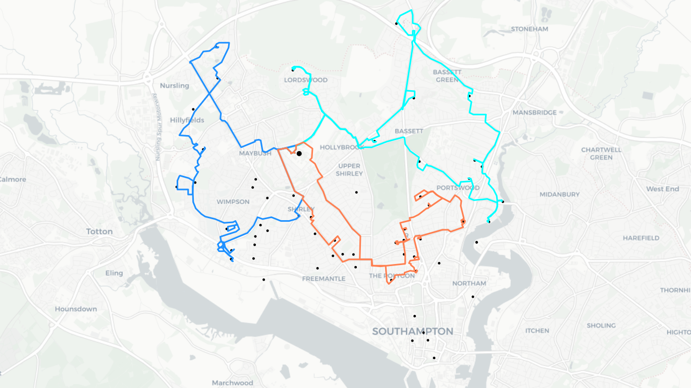
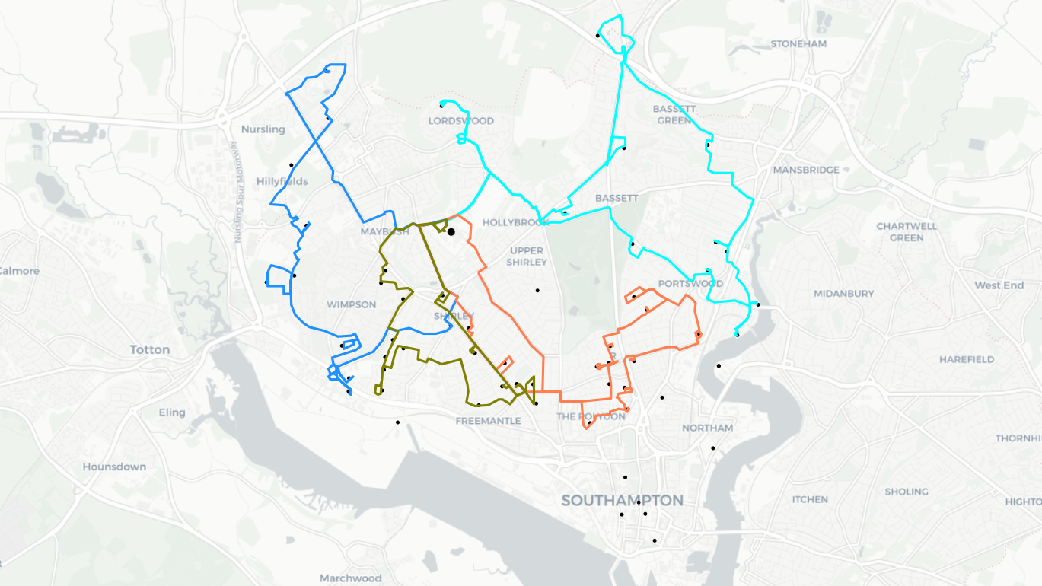
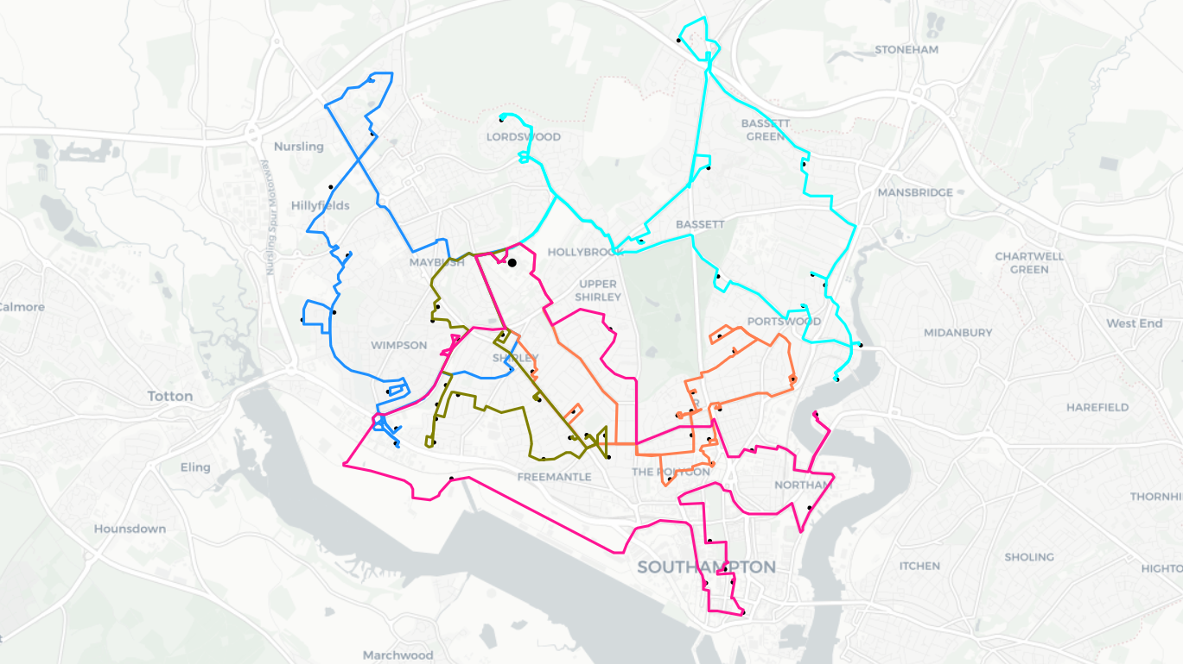
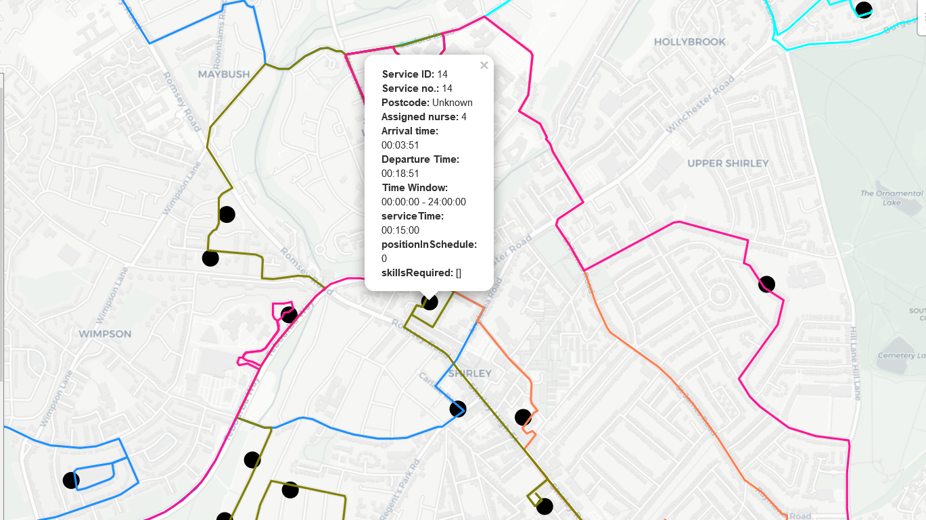

Slide 17
Questions?
References
Mankowska DS, Meisel F, Bierwirth C. The home health care routing and scheduling problem with interdependent services. Health Care Manag Sci 2014
Ait Haddadene SR, Labadie N, Prodhon C. A GRASP × ILS for the vehicle routing problem with time windows, synchronization and precedence constraints. Expert Syst Appl, 2016
Cissé M, Yalçındağ S, Kergosien Y, Şahin E, Lenté C, Matta A. OR problems related to Home Health Care: A review of relevant routing and scheduling problems. Vols. 13–14, Operations Research for Health Care. Elsevier; 2017. p. 1–22.

